Slide 1

Collaborative Filtering Based Recommender & Hybrid Recommender System

Slide 2


Team
Swathi Gurijala(C0790294)
Varadharajan Kalyanaraman(C0793756)
Vignesh Kumar Murugananthan(C0793760)

Slide 3
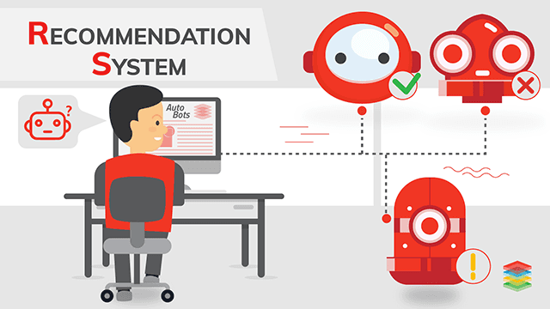
Recommender Systems
Recommender systems are algorithms aimed at suggesting relevant items to users (items being movies to watch, text to read, products to buy or anything else depending on industries) services.

Slide 4
Project Workflow
Inception
Team Kick-off
Requirements
Project Workflow
Feedback
Development
Twitter API
Demonstration
Data Collection
Data Pre-Processing
Data Analysis
Presentation
Tools & Technologies
Data Sources
Project Concept
Recommender Systems

Slide 5

Dataset Description:
The dataset is from the Movie Lens dataset collected by the Group Lens Research Project at the University of Minnesota.
This data set consists of:
100,000 ratings (1-5) from 943 users on 1682 movies.
Each user has rated at least 20 movies.
u.data -- The full 'u' data set, 100000 ratings by 943 users on 1682 items. Each user has rated at least 20 movies. Users and items are numbered consecutively from 1. The data is randomly ordered.
u.item -- Information about the items (movies)
u.genre -- A list of the genres.

Slide 6
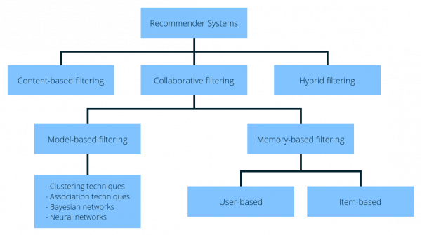
Recommender Systems Types
Introduction

Slide 7
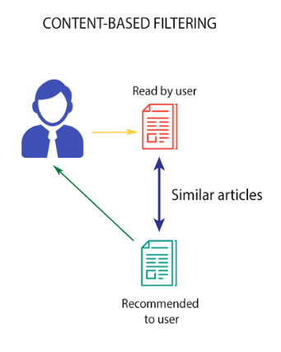
Content Based Filtering
Content-based Filtering is a Machine Learning technique that uses similarities in features to make decisions.
Algorithms designed to advertise or recommend things to users based on knowledge accumulated about the user.

Slide 8
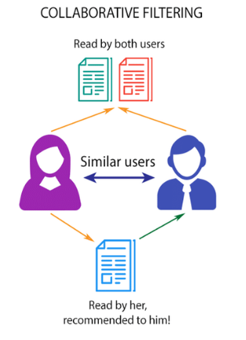
Collaborative Based Filtering
In the newer, narrower sense, collaborative filtering is a method of making automatic predictions (filtering) about the interests of a user by collecting preferences or taste information from many users.
There are two types –
Model Based
Memory Based

Slide 9
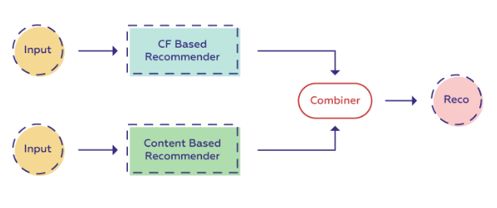
Hybrid Filtering

Slide 10


Related Study
Reviewed …??

Slide 11

Methodology

Slide 12

Matrix Factorization
Matrix factorization is a way to generate latent features when multiplying two different kinds of entities.
Collaborative filtering is the application of matrix factorization to identify the relationship between items’ and users’ entities.
With the input of users’ ratings on the shop items, we would like to predict how the users would rate the items so the users can get the recommendation based on the prediction.

Slide 13
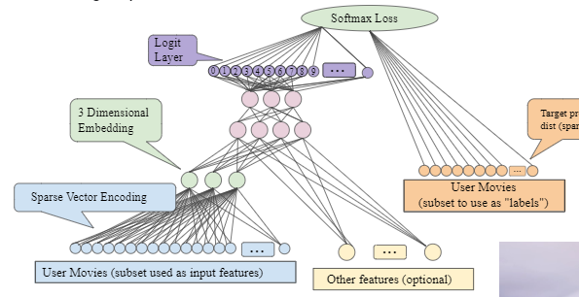
Neural Embedding Layer
Neural network embeddings are learned low-dimensional representations of discrete data as continuous vectors. These embeddings overcome the limitations of traditional encoding methods and can be used for purposes such as finding nearest neighbors, input into another model, and visualizations.
Word embeddings are a representation of the *semantics* of a word, efficiently encoding semantic information that might be relevant to the task at hand.

Slide 14
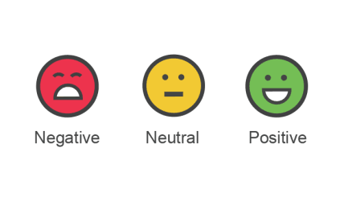
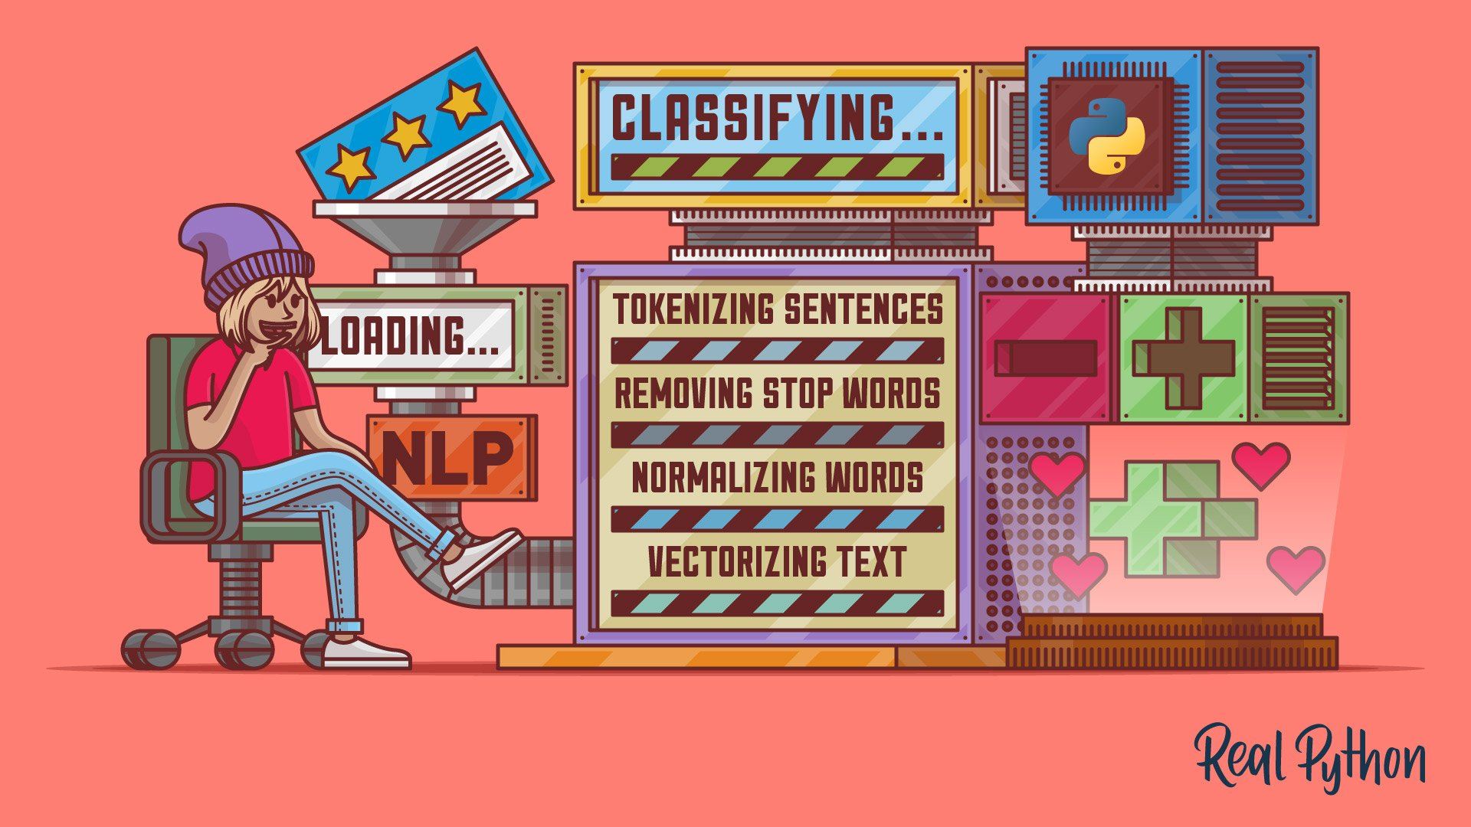
Sentiment Score Calculation
For Sentiment and Emotion Analysis, we considered many different tools but ended up selecting VADER.
VADER (or Valence Aware Dictionary and sEntiment Reasoner) is a binary Sentiment Analysis tool using a dictionary approach, containing 7.518 uni-grams including punctuation, slang words, initialisms, acronyms and emoticons.
Notes:
VADER is widely used and preferred as a sentiment analysis tool because of its advanced heuristics.
It includes 5 built-in and pre-trained heuristics taking into consideration punctuation marks (especially exclamation points), capitalization, degree modifiers (boosters and dampeners) Shift Polarity (with words like “but”) and Negation Handling using tri-grams.

Slide 15
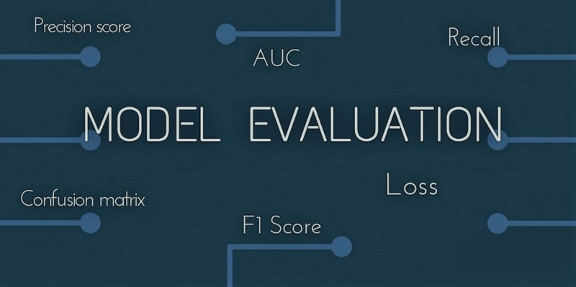
Evaluation Metrics
RMSE
MAE
PRECISION
RECALL
F1-SCORE

Slide 16

Code Walkthrough

Slide 17


